Slide 1
Test Cases for a Translating Hyperbolic Function
Simone Venturi, Tiernan Casey
Extreme-Scale Data Science & Analytics (8739)
Part of the Code Documentation for Neural Networks for Reduced Order Modeling (ROMNet)

Slide 2
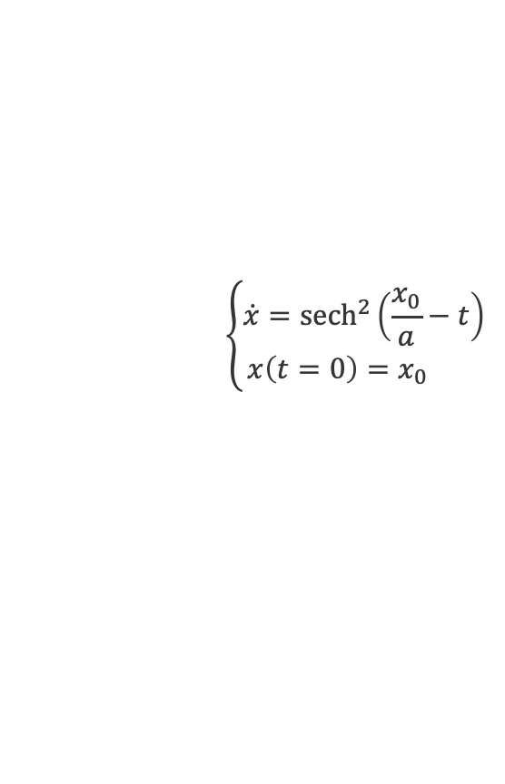
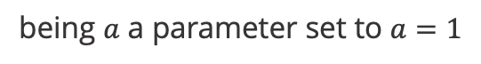
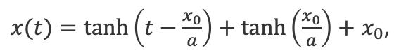
A Translating Hyperbolic Tangent Test Case
Equations of motion:
Some training scenarios
$$\left\{\begin{aligned}\dot{x}={sech}^{2}\left(\frac{x_{0}}{a}−t\right) \\ x\left(t=0\right)=x_{0} \end{aligned}\right.$$
which has solution:
$x(t)=\tanh\left(t−\frac{x_{0}}{a}\right)+\tanh\left(\frac{x_{0}}{a}\right)+$ $x_{0}$,
being $a$ a parameter set to $a=1$
The physical system is implemented in
$WORKSPACE_PATH/ROMNet/romnet/romnet/pinn/system/transtanh.py
The m, c, and k parameters can be found in
$WORKSPACE_PATH//ROMNet/romnet/database/TransTanh/Params/

Slide 3
A Translating Hyperbolic Tangent Test Case
Run Jupyter Notebook /ROMNet/romnet/scripts/generating_data/TransTanh/Generate_Data_1.ipynb
for generating training and test data

Slide 4
A Translating Hyperbolic Tangent Test Case
Test Cases 5 & 6

Slide 5
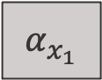
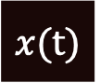
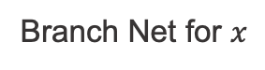
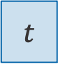
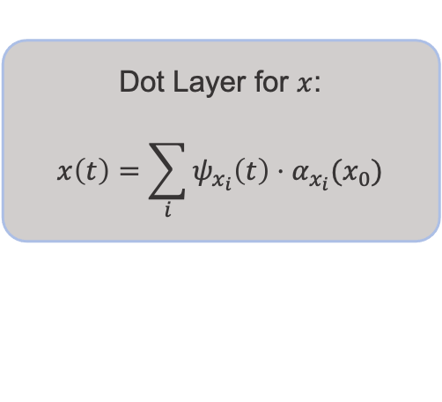
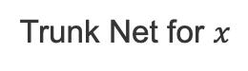
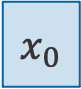
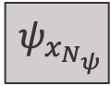

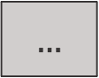
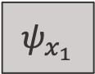

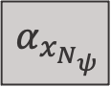
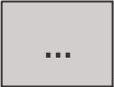
A Translating Hyperbolic Tangent Test Case
Branch Net for $x$
$$α_{x_{1}}$$
DeepONet Structure
$$x_{0}$$
32, Tanh
32, Tanh
32, Tanh
$N_{ψ}$, Linear
$$…$$
$$α_{x_{N_{ψ}}}$$
Dot Layer for $x$:
$$x\left(t\right)=\sum_{i}{ψ_{x_{i}}\left(t\right)⋅α_{x_{i}}(x_{0})}$$
$$x(t)$$
$$ψ_{x_{1}}$$
Trunk Net for $x$
32, Tanh
32, Tanh
32, Tanh
$N_{ψ}$, Linear
$$…$$
$$t$$
$$ψ_{x_{N_{ψ}}}$$

Slide 6
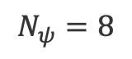
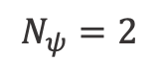
A Translating Hyperbolic Tangent Test Case
Results on training scenarios
$$N_{ψ}=2$$
$$N_{ψ}=8$$

Slide 7
A Translating Hyperbolic Tangent Test Case
Test Case 5: Data-driven deep operator network (DeepONet) for predicting position
5.1. Copy $WORKSPACE_PATH/ROMNet/romnet/input/TransTanh/DeepONet/TestCase5/ROMNet_Input.py
to $WORKSPACE_PATH/ROMNet/romnet/input/ROMNet_Input.py
5.2. In $WORKSPACE_PATH/ROMNet/romnet/input/ROMNet_Input.py, change:
5.2.1. "self.WORKSPACE_PATH = ..."
5.3. Move to $WORKSPACE_PATH/ROMNet/romnet/app/
5.4. Run: "python3 ROMNet.py ../input/
5.5. Postprocess results via: $WORKSPACE_PATH/ROMNet/romnet/scripts/postprocessing/TransTanh/DeepONet/Predict_DeepONet.ipynb

Slide 8
A Translating Hyperbolic Tangent Test Case
Test Case 6: Physics-Informed deep operator network (DeepONet) for predicting position
6.1. Copy $WORKSPACE_PATH/ROMNet/romnet/input/TransTanh/DeepONet/TestCase6/ROMNet_Input.py
to $WORKSPACE_PATH/ROMNet/romnet/input/ROMNet_Input.py
6.2. In $WORKSPACE_PATH/ROMNet/romnet/input/ROMNet_Input.py, change:
6.2.1. "self.WORKSPACE_PATH = ..."
6.3. Move to $WORKSPACE_PATH/ROMNet/romnet/app/
6.4. Run: "python3 ROMNet.py ../input/
6.5. Postprocess results via: $WORKSPACE_PATH/ROMNet/romnet/scripts/postprocessing/TransTanh/DeepONet/Predict_DeepONet.ipynb

Slide 9
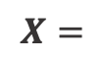
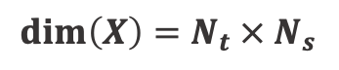
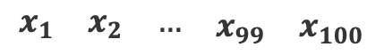
A Translating Hyperbolic Tangent Test Case
A scenario-aggregated Principal Component Analysis
By aggregating the training scenarios for $x_{i}\left(t\right)$, where $i$ represents the scenario index:
$$X=$$
$$\begin{matrix}\begin{matrix}x_{1} & x_{2} & …\end{matrix} & x_{99} & x_{100}\end{matrix}$$
$$dim\left(X\right)={N_{t} × N}_{s}$$
No of time
instants
No of
scenarios

Slide 10
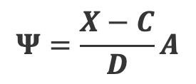
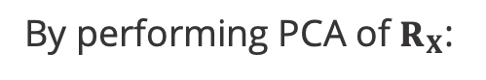
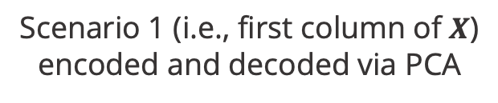
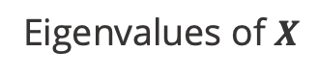
A Translating Hyperbolic Tangent Test Case
$$Ψ=\frac{X−C}{D}A$$
By performing PCA of $R_{X}$:
Scenario 1 (i.e., first column of $X$)
encoded and decoded via PCA
Eigenvalues of $X$

Slide 11
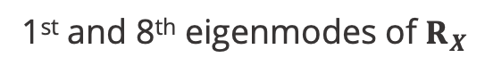
A Translating Hyperbolic Tangent Test Case
1st and 8th eigenmodes of $R_{X}$
Note: The high-frequency character of the low-energy modes makes them
harder to be fitted with high accuracy
However, we know from the analytical solution that the number of modes can be reduced to one by properly taking care of the translational invariance

Slide 12
A Translating Hyperbolic Tangent Test Case
Run Jupyter Notebook /ROMNet/romnet/scripts/generating_data/TransTanh/Generate_Data_2.ipynb
for generating PCA data

Slide 13
A Translating Hyperbolic Tangent Test Case
We suggest two improvements to the original DeepONet Structure:
Improvement 1:
Effective PCA must be preceded by centering and scaling [1-5].
“Since the variables are characterized by different units and ranges, preprocessing in the form of centering and scaling is a mandatory operation [1, 2]. Data centering consists of subtracting the mean value of each variable to all dataset observations: in this way, all the observations can be seen as fluctuations from a mean value. Scaling is achieved by dividing each variable by a given scaling factor, which can be different depending on the adopted scaling criterion.
…
The way data are preprocessed can have a strong influence on the data analysis and the reduced-order modeling for combustion applications [3], as the scaling technique can be more or less sensitive to the presence of outliers or it can highlight a specific pattern in the data” [6]
[1] Rasmus Bro and Age K. Smilde - Centering and scaling in component analysis - 2001
[2] Robert A van den Berg et al. - Centering, scaling, and transformations: improving the biological information content of … - 2006
[3] A. Parente and J. C. Sutherland - Principal component analysis of turbulent combustion data: Data pre-processing and … - 2012
[4] A. Armstrong and J. C. Sutherland - A technique for characterising feature size and quality of manifolds – 2021
[5] K. Zdybal et al - PCAfold: Python software to generate, analyze and improve PCA-derived low-dimensional manifold – 2021
[6] G. D’Alessio et al - Analysis of Turbulent Reacting Jets via Principal Component Analysis - 2020

Slide 14
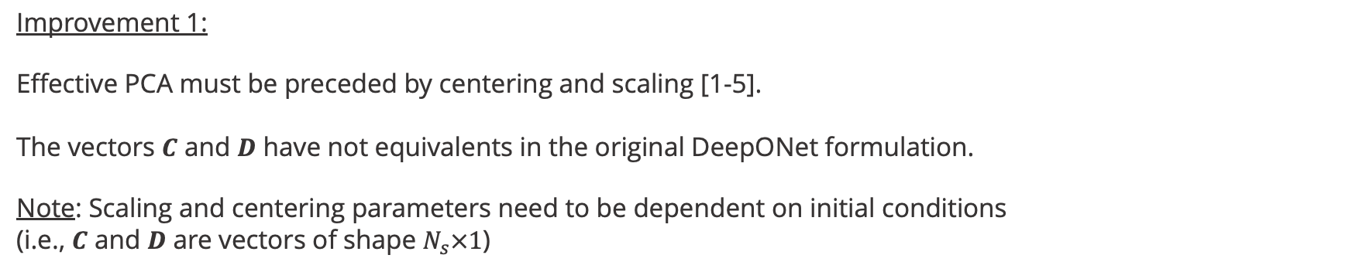
A Translating Hyperbolic Tangent Test Case
We suggest two improvements to the original DeepONet Structure:
Improvement 1:
Effective PCA must be preceded by centering and scaling [1-5].
The vectors $C$ and $D$ have not equivalents in the original DeepONet formulation.
Note: Scaling and centering parameters need to be dependent on initial conditions
(i.e., $C$ and $D$ are vectors of shape $N_{s}×1$)
[1] Rasmus Bro and Age K. Smilde - Centering and scaling in component analysis - 2001
[2] Robert A van den Berg et al. - Centering, scaling, and transformations: improving the biological information content of … - 2006
[3] A. Parente and J. C. Sutherland - Principal component analysis of turbulent combustion data: Data pre-processing and … - 2012
[4] A. Armstrong and J. C. Sutherland - A technique for characterising feature size and quality of manifolds – 2021
[5] K. Zdybal et al - PCAfold: Python software to generate, analyze and improve PCA-derived low-dimensional manifold – 2021
[6] G. D’Alessio et al - Analysis of Turbulent Reacting Jets via Principal Component Analysis - 2020

Slide 15
A Translating Hyperbolic Tangent Test Case
Note 1: Bias term
Multiple references [1,2] introduce the bias term, but:
In none it is justified (e.g., ”… where we include an additional bias term b0 as a trainable variable as it may reduce the generalization error” [2])
In none it depends on the initial conditions (e.g., “… \phi_0(\epsilon is the mean function of u(\epsilon) computed from the training data-set” [1])
[1] L. Lu et al - Learning nonlinear operators via DeepONet based on the universal approximation theorem of operators - 2021
[2] M. Yin et al - Simulating progressive intramural damage leading to aortic dissection using an operator-regression neural network - 2022

Slide 16
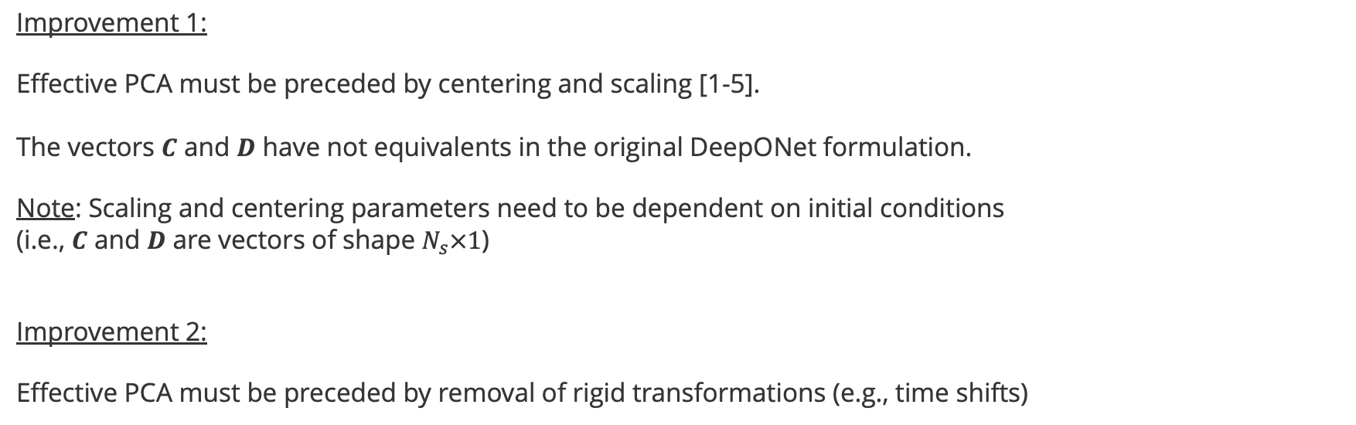
A Translating Hyperbolic Tangent Test Case
We suggest two improvements to the original DeepONet Structure:
Improvement 1:
Effective PCA must be preceded by centering and scaling [1-5].
The vectors $C$ and $D$ have not equivalents in the original DeepONet formulation.
Note: Scaling and centering parameters need to be dependent on initial conditions
(i.e., $C$ and $D$ are vectors of shape $N_{s}×1$)
Improvement 2:
Effective PCA must be preceded by removal of rigid transformations (e.g., time shifts)

Slide 17
A Translating Hyperbolic Tangent Test Case
Test Cases 7 & 8

Slide 18
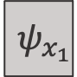
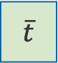
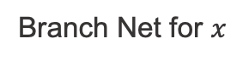
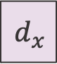
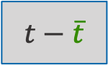
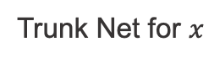
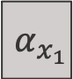
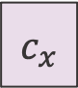
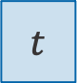
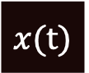
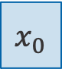
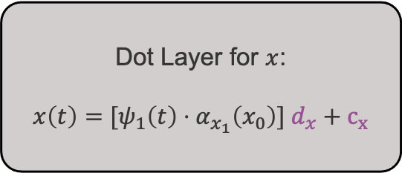
A Translating Hyperbolic Tangent Test Case
Branch Net for $x$
$$α_{x_{1}}$$
3, Tanh
3, Linear
Suggested Improved Structure
for the DeepONet
$$x_{0}$$
$$c_{x}$$
$$d_{x}$$
Shift Net
1, Linear
Dot Layer for $x$:
$x\left(t\right)=$ $[ψ_{1}\left(t\right)⋅α_{x_{1}}\left(x_{0}\right)] d_{x}+c_{x}$
$$x(t)$$
$$\overline{t}$$
Trunk Net for $x$
$$t$$
$$t−\overline{t}$$
1, Tanh
$$ψ_{x_{1}}$$

Slide 19
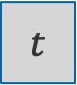
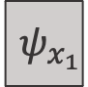
A Translating Hyperbolic Tangent Test Case
Results from the improved structure
Some test scenarios
Trunk output
(w/o including shifting
block’s pre-transformation)
Trunk Net for $x$
$$t$$
1, Tanh
$$ψ_{x_{1}}$$

Slide 20
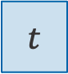
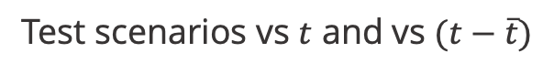
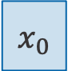
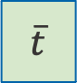
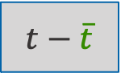
A Translating Hyperbolic Tangent Test Case
Results from the improved structure
$$x_{0}$$
Test scenarios vs $t$ and vs $(t−\overline{t})$
Shift Net
1, Linear
$$\overline{t}$$
$$t$$
$$t−\overline{t}$$

Slide 21
A Translating Hyperbolic Tangent Test Case
Test Case 7: Data-driven improved deep operator network (DeepONet) for predicting position
7.1. Copy $WORKSPACE_PATH/ROMNet/romnet/input/TransTanh/DeepONet/TestCase7/ROMNet_Input.py
to $WORKSPACE_PATH/ROMNet/romnet/input/ROMNet_Input.py
7.2. In $WORKSPACE_PATH/ROMNet/romnet/input/ROMNet_Input.py, change:
7.2.1. "self.WORKSPACE_PATH = ..."
7.3. Move to $WORKSPACE_PATH/ROMNet/romnet/app/
7.4. Run: "python3 ROMNet.py ../input/
7.5. Postprocess results via: $WORKSPACE_PATH/ROMNet/romnet/scripts/postprocessing/TransTanh/DeepONet/Predict_DeepONet.ipynb

Slide 22
A Translating Hyperbolic Tangent Test Case
Test Case 8: Physics-Informed improved deep operator network (DeepONet) for predicting position
8.1. Copy $WORKSPACE_PATH/ROMNet/romnet/input/TransTanh/DeepONet/TestCase8/ROMNet_Input.py
to $WORKSPACE_PATH/ROMNet/romnet/input/ROMNet_Input.py
8.2. In $WORKSPACE_PATH/ROMNet/romnet/input/ROMNet_Input.py, change:
8.2.1. "self.WORKSPACE_PATH = ..."
8.3. Move to $WORKSPACE_PATH/ROMNet/romnet/app/
8.4. Run: "python3 ROMNet.py ../input/
8.5. Postprocess results via: $WORKSPACE_PATH/ROMNet/romnet/scripts/postprocessing/TransTanh/DeepONet/Predict_DeepONet.ipynb

Slide 23
The input file for Test Case 7 differs from the one of Test Case 5 Part 4 for:
self.n_branch_out: We added other two neurons to the last layer of the brunch net (i.e., centering and scaling)
Note:
If self.n_branch_out == self.n_modes: No centering, no scaling
If self.n_branch_out == self.n_modes+1: Only centering
If self.n_branch_out == self.n_modes+2: Centering and scaling
self.structure: We added a rigid block to the structure …
self.rigid_type: … and it’s of shifting type

